Slide 1
Extra Credit Opportunity: +0.5% on your final grade for CS1101
+ improve your own code reading skills with an additional study resource

Slide 2
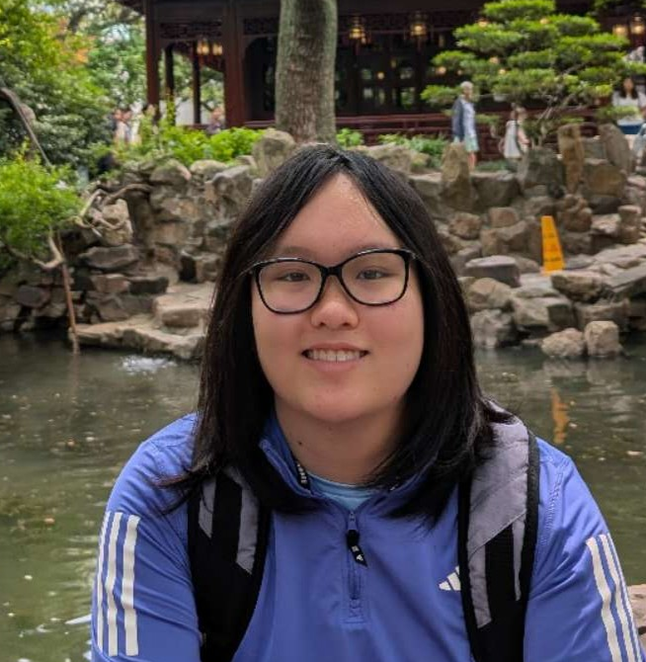
Helen Wu
CS 1101 TA (Aug 2024-Present)
Undergrad Junior & Masters
Computer Science + Math, Digital Fabrication
Email: helen.wu@vanderbilt.edu

Slide 3
Questions on Learner’s Code (QLCs): reviewing strategy for CS students
Previous studies: CS students struggle to explain code they wrote
CS students submit code for PAs
Create test-like questions from code submission
Students answer the questions
My study: use LLMs to generate QLCs from peer student code

Slide 4
Q: What are the incentives?
Extra Credit (+0.5 on your final grade!)
Additional study resource for exams
Low time commitment
Participate in feedback for future app development

Slide 5
Q: Can you participate in the research study?
Eligibility: at least 18 years old and in CS 1101 Spring 2026

Slide 6
Q: Can you get extra credit if you aren’t eligible?
If you are not eligible, you can still complete the tasks for the extra credit; for research purposes, the data will be grouped separately. Reach out to me for more clarification about this.

Slide 7
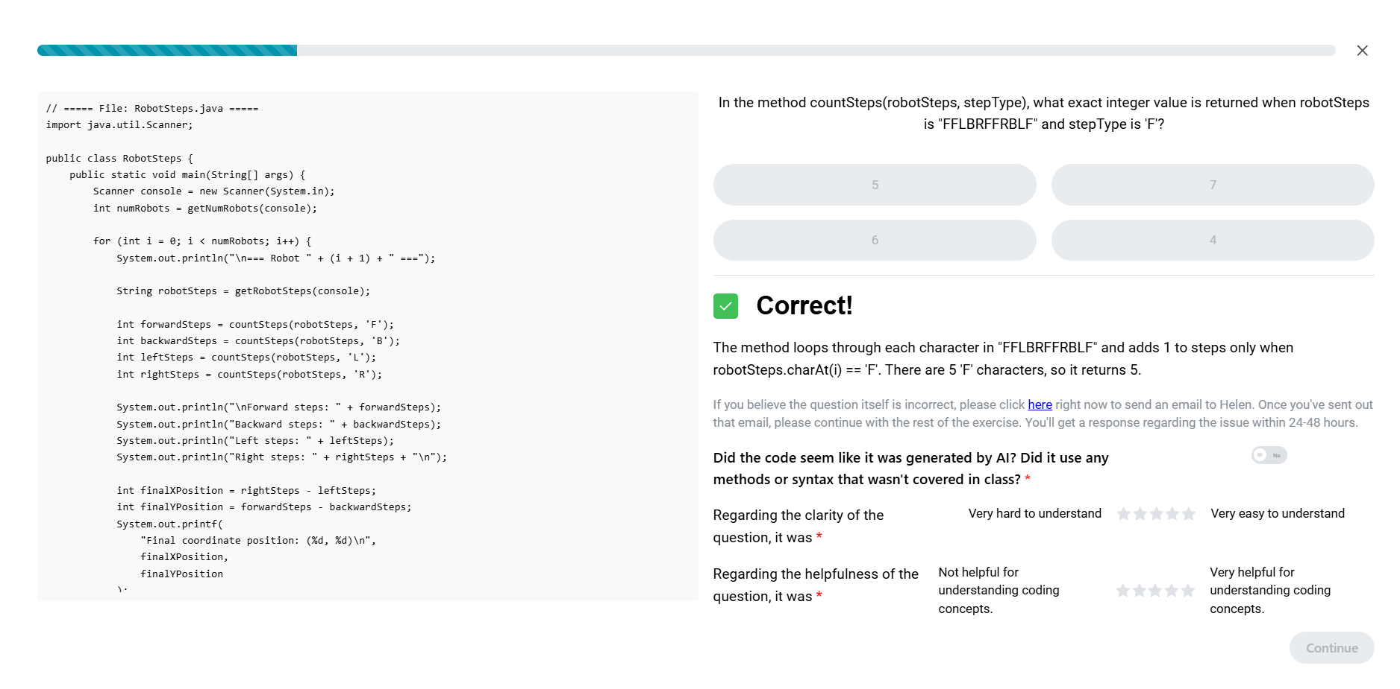
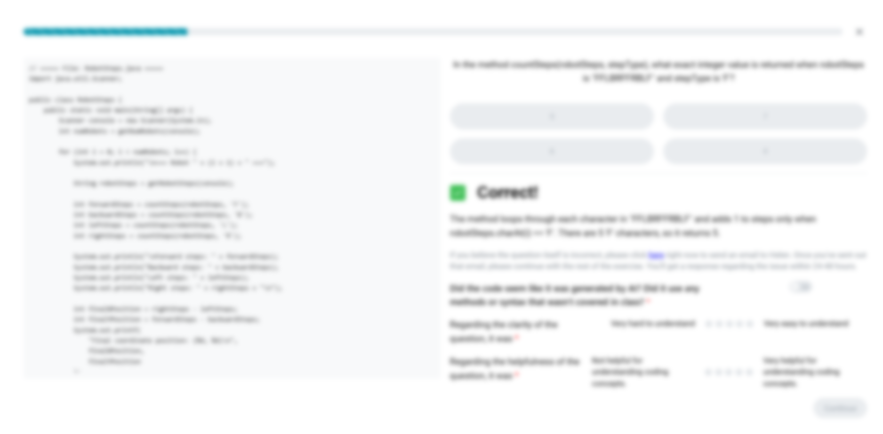
Q: What do you need to do? (Part 1)
Access the website application I built and finish at least 90% of assigned weekly exercises fully
An exercise will have 5 MCQ about a student submission
Each PA has an exercise; exercises due before next PA deadline (will send reminder)
After each question is answered, give quick ratings on question quality

Slide 8
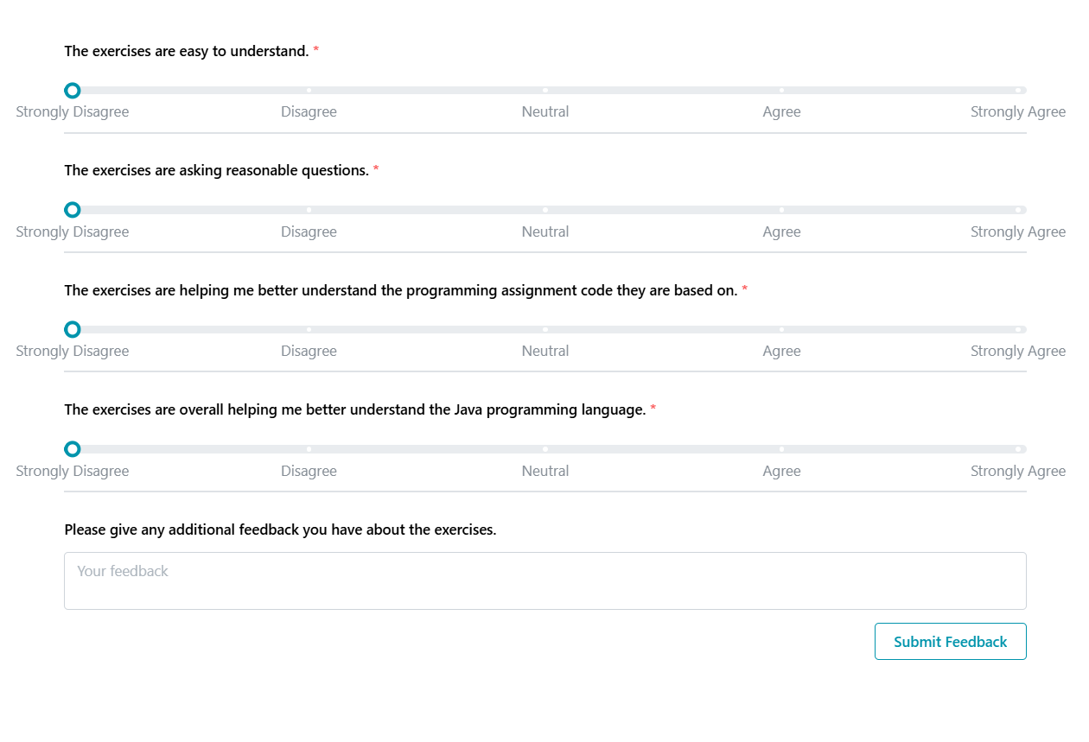
Q: What do you need to do? (Part 2)
Provide general feedback on the QLC experience
Strongly Agree – Strongly Disagree
Will be assigned every other week (ex. PA06 has feedback form, PA07 does not, PA08 has feedback form…)
Due when its corresponding PAs are due

Slide 9
Summary of Requirements
Required Tasks | Description | Extra Time
Submit your PAs | You do that already! | +0
Finish at least 90% of assigned weekly exercises fully | Due before next PA deadline MCQ about a student submission Give quick ratings on question quality | +5-20 minutes per week
Provide feedback on overall experience | Feedback form assigned occasionally Due at the same time as corresponding exercises | +1 minute per week
Note: you must do all these tasks in full to receive extra credit. We will not provide partial credit.

Slide 10
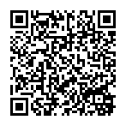
Questions?
To participate:
https://redcap.vumc.org/surveys/?s=XEFPCEMRC88947AR
https://helen.cumberland.isis.vanderbilt.edu/
Both items due before March 2 @ 11:59pm!
Email: helen.wu@vanderbilt.edu
OH: 10:00 am – 12:00 pm, Friday and Saturdays in FGH 314

